Slide 1
Week 4 - Exercise Session
Module 2 – Acoustic Communication
Tanmayee Pathre
PhD Student
Department of the Built Environment
Building Acoustics Group
4th March, 2021

Slide 2
Chapter 15 – Review Questions – 2, 5, 12
2) Describe the way in which the vocal folds vibrate.
The vocal folds are caused to open by air pressure in the trachea, which tends to blow them upward and outward. As the air velocity increases, the pressure decreases between them, and they are pulled back together by the Bernoulli force Ordinarily, however, the restoring force supplied by the muscles exceeds the Bernoulli force. (Book – Pg. 343)

Slide 3
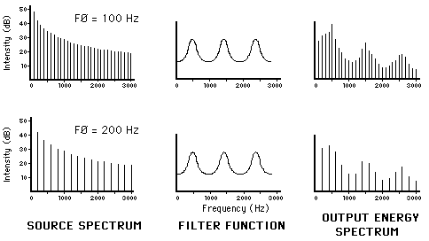
Chapter 15 – Review Questions – 2, 5, 12
5) Describe the spectrum of the glottal source function. – Source-filter model of speech production
Source: http://www.haskins.yale.edu/featured/heads/mmsp/acoustic.html#:~:text=The%20source%20spectrum%20represents%20the,fundamental%20frequency%20of%20100%20Hz.&text=Energy%20is%20present%20at%20all,amplitudes%20and%20the%20filter%20function.

Slide 4
Chapter 15 – Review Questions – 2, 5, 12
12) What are prosodic features of speech? Give two examples.
Prosodic features – characteristics of speech conveying meaning, emphasis and emotion without changing phonemes (from SOS Reference Book)
Examples:
Emphasis (Stress) – Could you do this! , Could you do this?
Rhythm
Intonation
http://www.phon.ox.ac.uk/jcoleman/PROSODY1.html

Slide 5







Chapter 15 – Exercises – 1, 4, 6
Calculate the first three resonances of a tube 11 cm long (the approximate length of a child’s vocal tract) open at one end and closed at the other. Compare these to the formant frequencies for /$ε$/ given in Table 15.3.
l = 11 cm
$$c≈340 m/s$$
$$l= \frac{λ}{4}$$
$$f=\frac{c}{λ}$$
F1 $=772 Hz$
F2 $=2318 Hz$
F3 $=3860 Hz$

Slide 6
Chapter 15 – Exercises – 1, 4, 6
4) Express in Newton/meter^2 the maximum and minimum lung pressures used in speech (4 cm and 20 cm of water). Atmospheric pressure (10^5 N/m^2) corresponds to a manometer pressure of about 34 ft of water.
34 ft = 1036.32 cm
$Maximum lung pressure= 387 N/m^2$, for 4 cm of water
$$Minimum lung pressure= 1929\frac{N}{m^{2}}, \text{for}\text{ 20 }\text{cm} \text{of} \text{water}$$
Additional source: http://my.ilstu.edu/~jsawyer/NIUrespiration/NIUrespiration5.html

Slide 7



Chapter 15 – Exercises – 1, 4, 6
6) Determine whether there is a “scaling factor” relating male and female vowel formants by the following calculations. Determine the ratios of the female-to-male formant frequencies for the vowels given in Table 15.3. Find the average ratio. Could recording male speech and playing it back 16% faster make it resemble female speech?
Example : /i/ - For F1
$$scaling factor=\frac{Female F1}{Male F1}$$
$$scaling factor=\frac{310 Hz}{270 Hz}$$
$$scaling factor=1.14$$
This means if F1 of male speaker is 100 Hz, female will be 114 Hz. If we play the F1 at 116 Hz. Then it will resemble female speech, theoretically speaking.

Slide 8
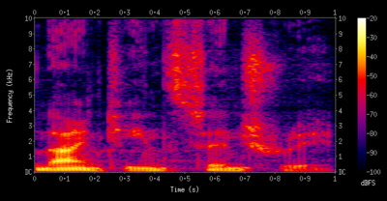
Chapter 16 – Review Questions – 2, 7, Q1
2) What three variables are plotted by a sound spectrograph? Time, Frequency, Sound level
Source - Wikipedia

Slide 9
Chapter 16 – Review Questions – 2, 7, Q1
7) Describe the first and second formants associated with the consonant /t /.
/t/ - Unvoiced Plosive or stop consonant
Depends on vowel which follows after the /t/. First and second formant associated with vowel that follows.

Slide 10
Chapter 16 – Review Questions – 2, 7, Q1
Q1) When you fail to understand an indistinctly spoken word, is it more apt to be the initial consonant, the final consonant, or the vowel that is not recognized? Try to give reasons for your answer.
Production of consonants dependent on place of articulation, manner of articulation and voicing.
Vowels are only voiced → vibration of vocal cords
Depends if the word begins with a vowel or a consonant.

